Slide 1


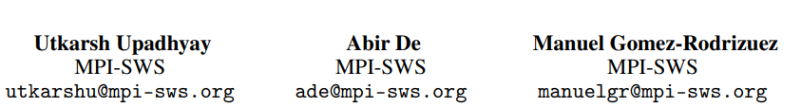
Deep Reinforcement Learning of
Marked Temporal Point Processes
(Published in NeurIPS-2018)
孙佳佳

Slide 2
Outline
Background
Representation of MTPPs
Reinforcement learning models
Policy Optimization
Evaluation

Slide 3
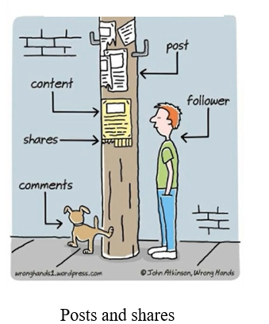

Discrete events in continuous time

Slide 4
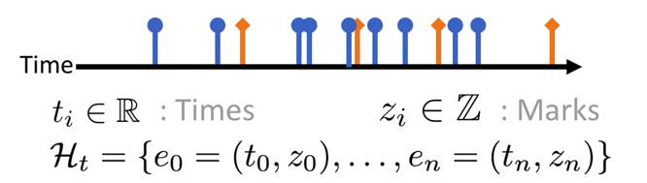
Marked temporal point processes
Sequence of events of type $𝓏_{i}$ with their times $t_{i}$
Continuous time
Discrete/continuous marks
Notes:
这类事件的特点是：在连续时间上的离散事件

Slide 5

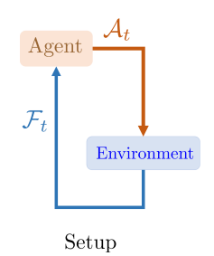
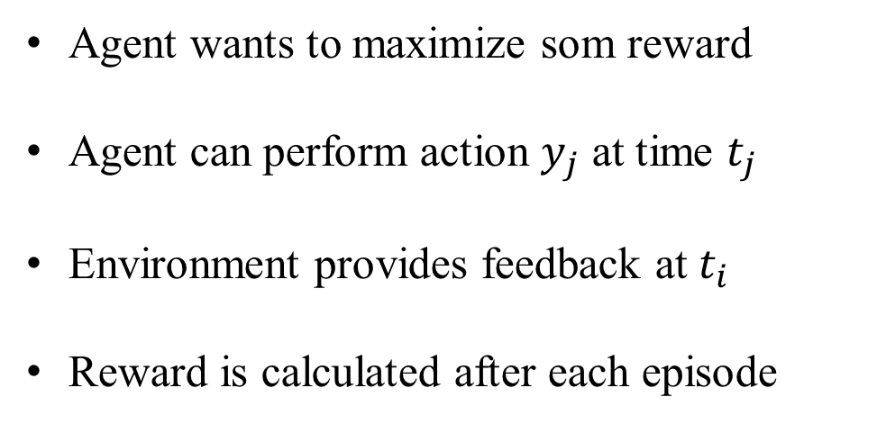
What can MTPPs model?
Agent wants to maximize som reward
Agent can perform action $y_{j}$ at time $t_{j}$
Environment provides feedback at $t_{i}$
Reward is calculated after each episode

Slide 6


思考IRL for TPP的定义
目标：想上热搜
action：when to repost
Reward：热搜排名
advertiser
Follower &
Other tweeters
$$R(T)=\frac{1}{T}\int_{0}^{T}{rank\left(t\right)dt}$$
feed sorting algorithm does only depends on the time of the post and the identity of the user who posts
How to learn reward function

Slide 7


Example 2: spaced-repetition
Duolingo
Duolingo wants to teach
Duolingo can ask questions
Learner can try to recall
Test score is calculated at the end of course
Learner
$$𝓐_{t}=\left\{\left(abandon, 9:05\right), \left(reinforce, 9:30\right), …\right\}$$
$$𝓕_{t}=\left\{\left(✓, 9:05\right), \left(✗, 9:30\right), …\right\}$$
$$R(T)=\left(exam time\right)$$

Slide 8
Current methods
Rely on SDE based modeling of the environment
Rely on carefully chosen reward functions
limitations
Feedback process model is complex/unknown
Reward function can be arbitrarily complex
Cannot leverage advances in deep learning

Slide 9
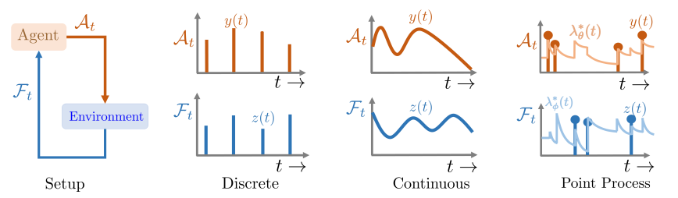
Classical RL is too restrictive
Classical RL
Actions and feedbacks at discrete time steps
Policy determines only the mark of actions
RL of MTPPs
Asynchronous actions and feedbacks in continuous time
Policy determines the time as well as mark of the next action
Arbitrary reward function

Slide 10
Outline
Background
Representation of MTPPs
Reinforcement learning models
Policy Optimization
Evaluation

Slide 11

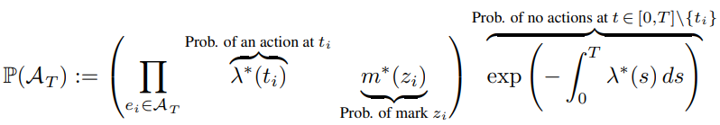
How to represent MTPPs
Intensity function:
Markd distribution:
Likelihood of
Notes:
当我们知道intensity function的定义之后，我们可以写出似然函数

Slide 12

How to represent our problem as MTPPs
Actions:
Feedbacks:
Model free reinforcement learning

Slide 13
Outline
Background
Representation of MTPPs
Reinforcement learning models
Policy Optimization
Evaluation

Slide 14
Reinforcement Learning model
Actions and feedback are asynchoronous
Characterized by intensity function
Design the policy
Realize the policy

Slide 15



Policy parametrization
Embed the history using RNN
Each event updates the hidden state
Intensity function is determined by

Slide 16


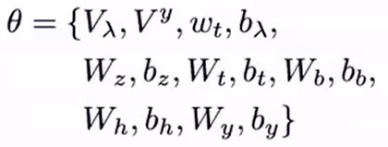
Embed the history using RNN
action
Input
layer
feedback
Hidden
layer
Output
layer

Slide 17
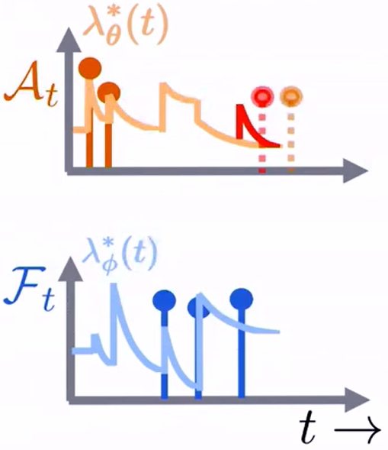
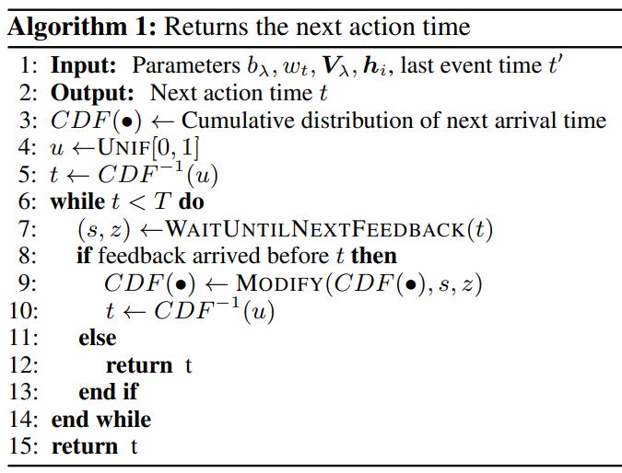
RL with Asynchronous Feedback
Distribution of actions may change because of incoming feedback

Slide 18
RL problem with PTPPs: summary
New: RL problem in continuous time with discrete events
Embedding state to real vectors using RNN
Efficient and unbiased sampling procedure to handle asynchronous feedbacks

Slide 19
Outline
Background
Representation of MTPPs
Reinforcement learning models
Policy Optimization
Evaluation

Slide 20


Policy Gradient method
Maximizing the expected reward
SGD Updates:
No need to model the feedback process
Reward function can be arbitrary
REINFORCE trick:

Slide 21
Outline
Background
Representation of MTPPs
Reinforcement learning models
Policy Optimization
Evaluation

Slide 22
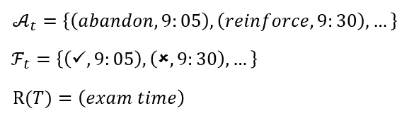
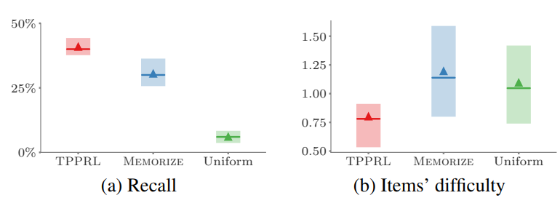
Spaced repetition
TPPRL | RL of MTPP; No assumption on feedback; Arbitrarily complex reward function
MEMORIZE | Has full access to the student model; Design specific reward function
Uniform | Choose items uniformly at random

Slide 23

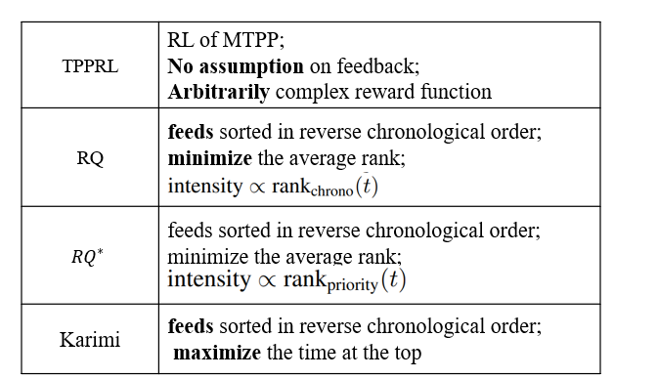
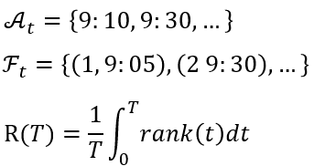
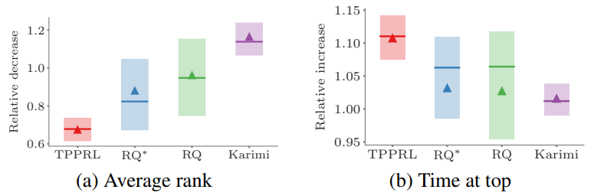
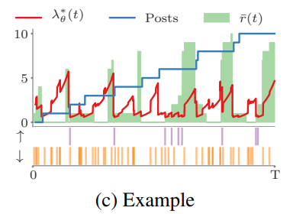
When to post
High priority
Low priority

Slide 24
Conclusion
Reinforcement Learning method for:
Asynchronous actions/rewards represented as MTPPs
Arbitrary reward functions
Funture work:
Deriving more sophisticated reinforcement learning algorithms
Multi-agent reinforcement learning

Slide 25
Thank you!

